Slide 1
CORONA VIRUS ANALYSIS
COVID-19 DATASET ANALYSIS USING SQL
BY
TIAMIYU NURUDEEN TOBILOBA

Slide 2
CONTENTS
INTRODUCTION
DATASET VIEW
DATA ANALYSIS OF THE DATASET
INSIGHT
CONCLUSION

Slide 3
INTRODUCTION
The CORONA VIRUS pandemic has had a significant impact on public health and has created an urgent
need for data-driven insights to understand the spread of the virus. As a data analyst, you have been
tasked with analyzing a CORONA VIRUS dataset to derive meaningful insights and present your findings.

Slide 4
DATASET VIEW
Description of each column in dataset:
Province: Geographic subdivision within a country/region.
Country/Region: Geographic entity where data is recorded.
Latitude: North-south position on Earth's surface.
Longitude: East-west position on Earth's surface.
Date: Recorded date of CORONA VIRUS data.
Confirmed: Number of diagnosed CORONA VIRUS cases.
Deaths: Number of CORONA VIRUS related deaths.
Recovered: Number of recovered CORONA VIRUS cases.

Slide 5
DATA ANALYSIS OF THE DATASET
Loading the Dataset
Cleaning Dataset
Analyzing the questions and answers

Slide 6
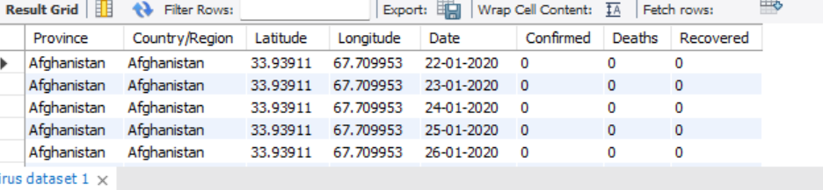
Loading the dataset
SELECT * FROM corona_data.`corona virus dataset`;

Slide 7
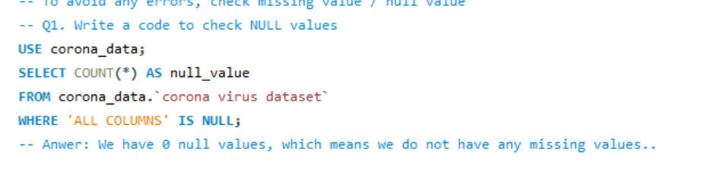
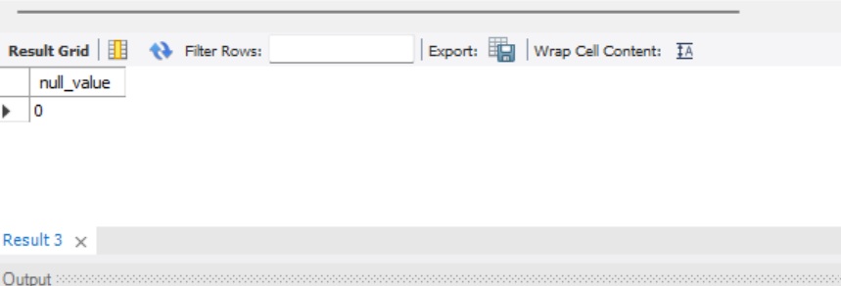
Cleaning the Dataset
Checking for missing value/Null Value

Slide 8
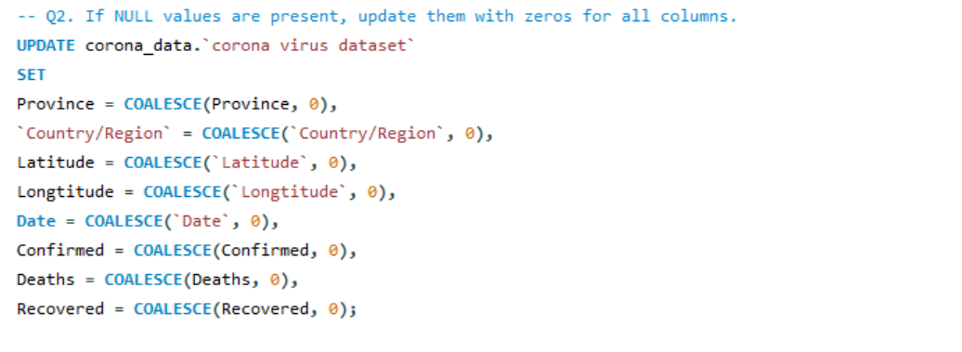
IF NULL VALUES ARE PRESENT,UPDATE THEM WITH ZEROS FOR ALL COLUMNS
The output for NULL values being present is zero, meaning there are no NULL values in any of the columns.

Slide 9
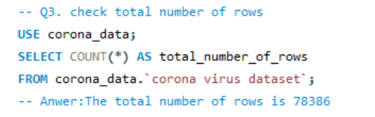
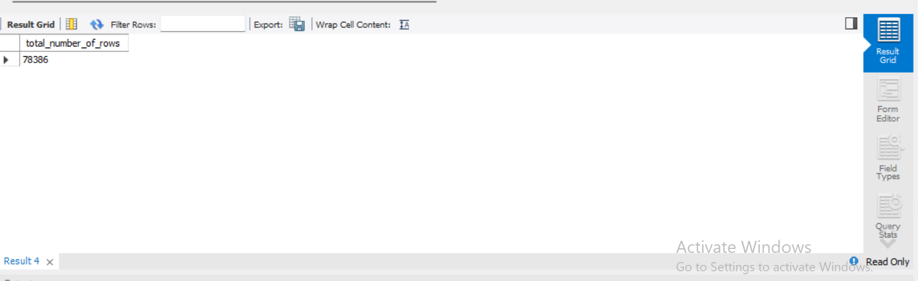
Analyzing the questions and answers
Check for total Numbers of Rows

Slide 10
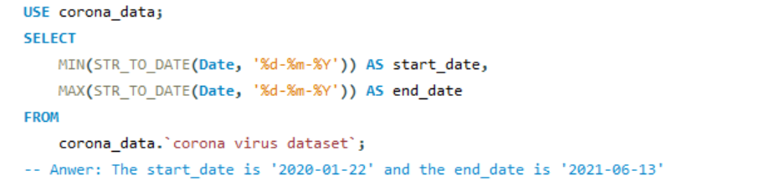
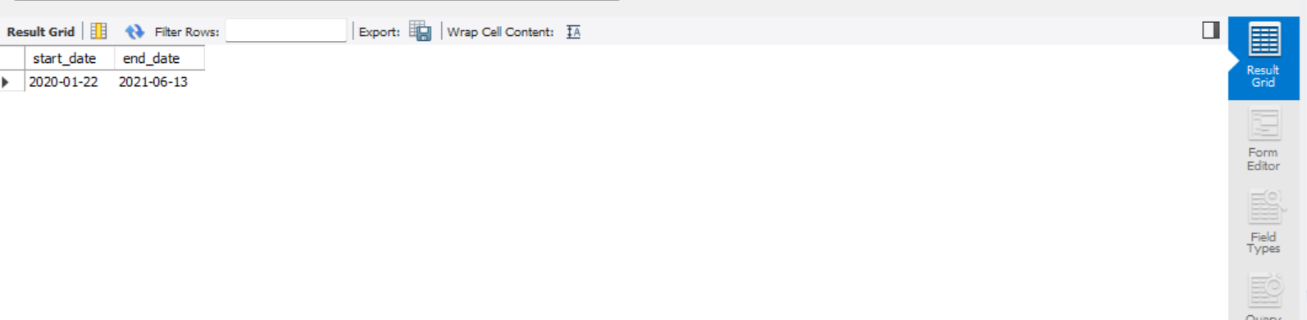
Check what is start_date and end_date

Slide 11
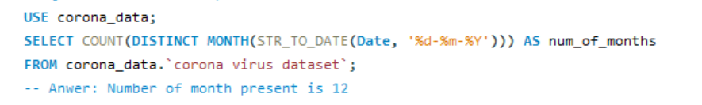
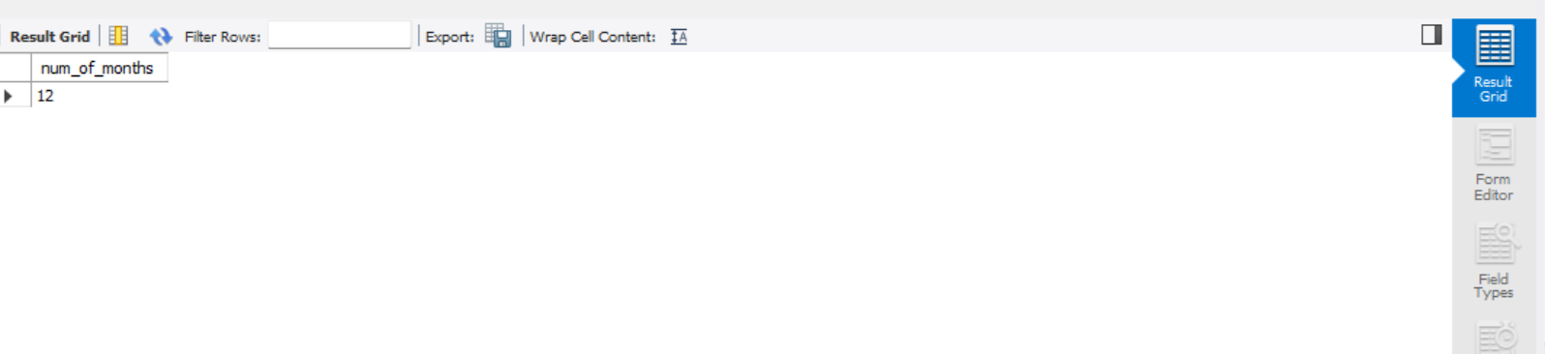
Number of month present in dataset

Slide 12
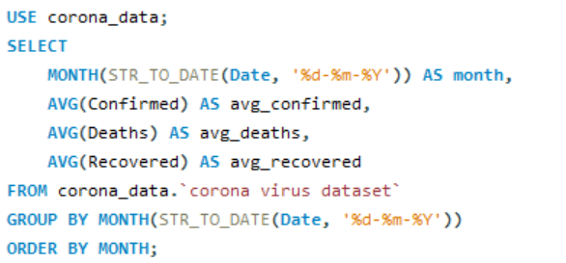
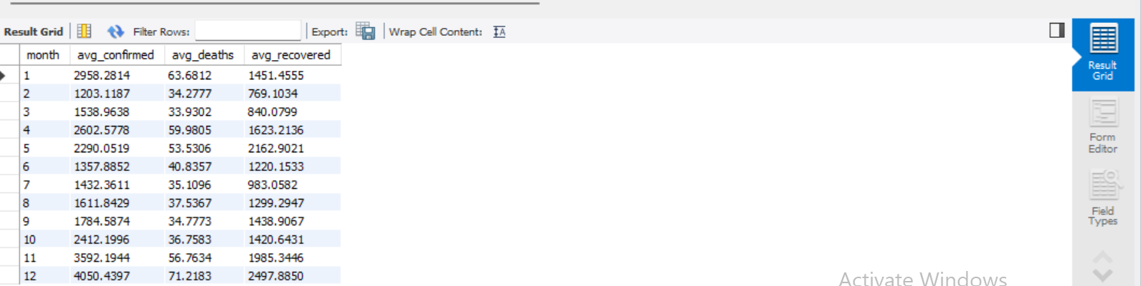
Find monthly average for confirmed, deaths, recovered

Slide 13
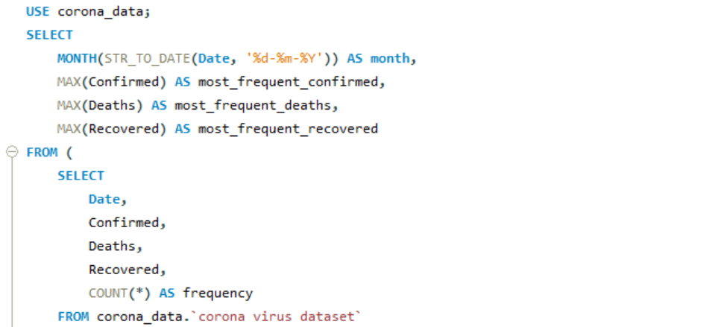
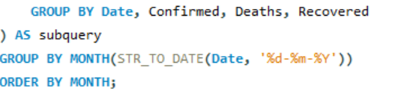
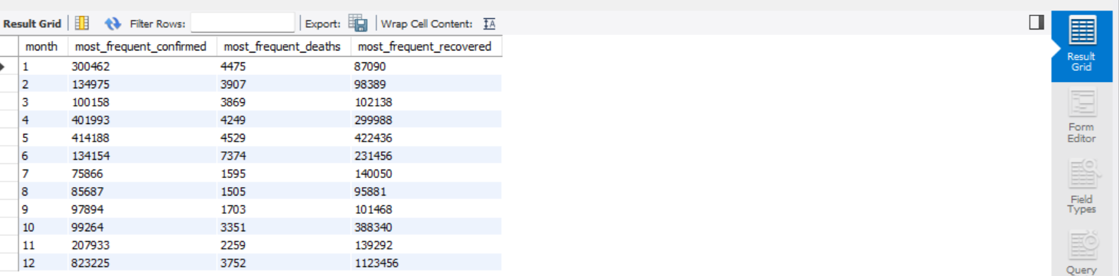
Find most frequent value for confirmed, deaths, recovered each month

Slide 14
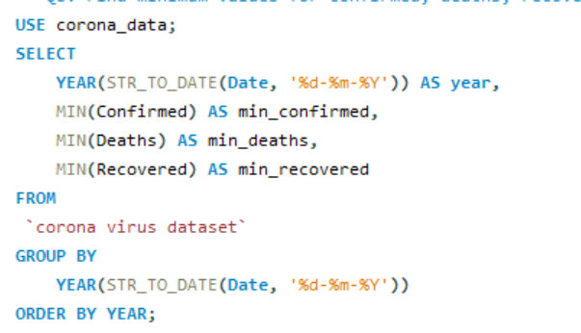
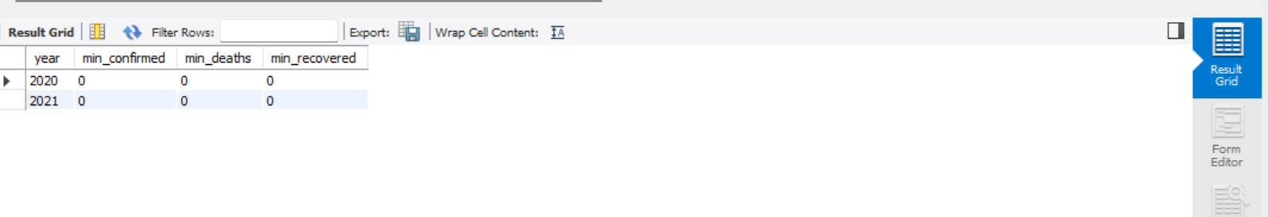
Find minimum values for confirmed, deaths, recovered per year

Slide 15
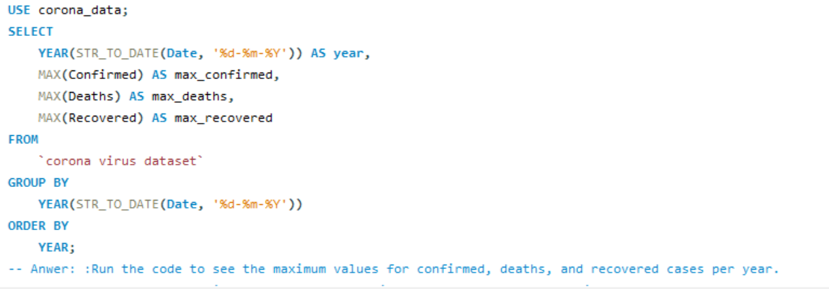
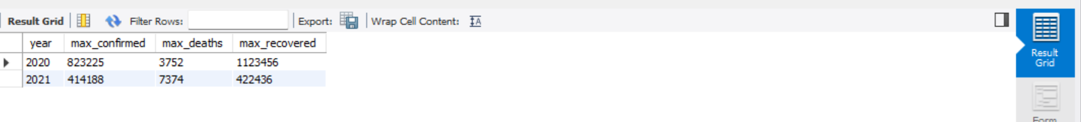
Find maximum values of confirmed, deaths, recovered per year

Slide 16
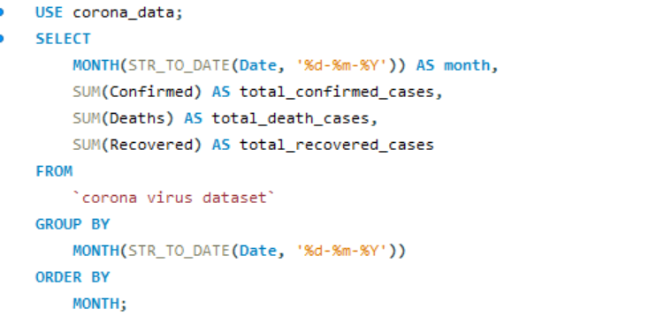
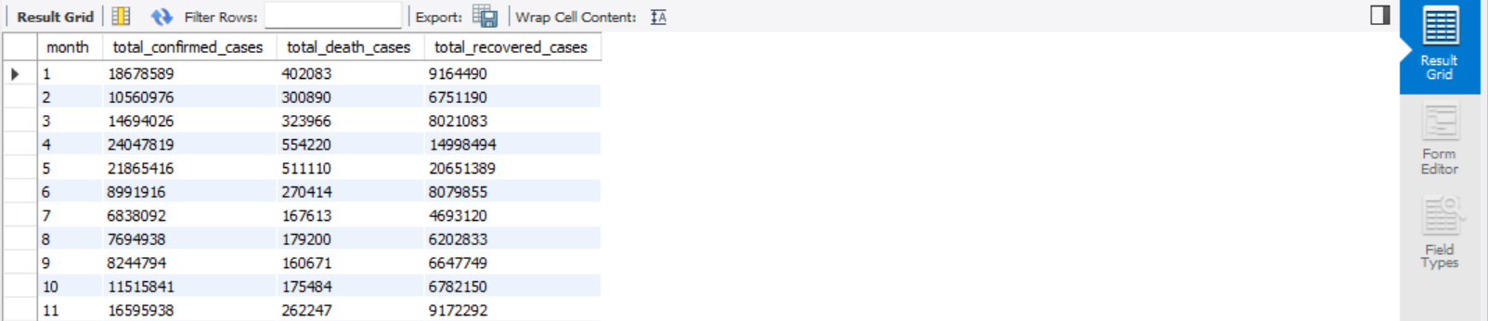
The total number of case of confirmed, deaths, recovered each month

Slide 17
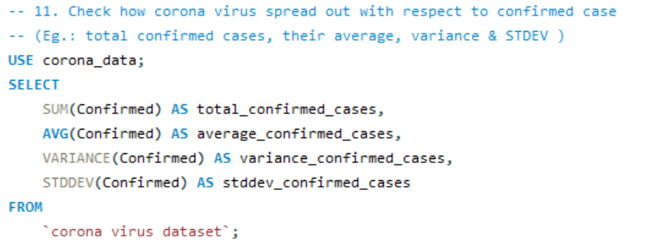
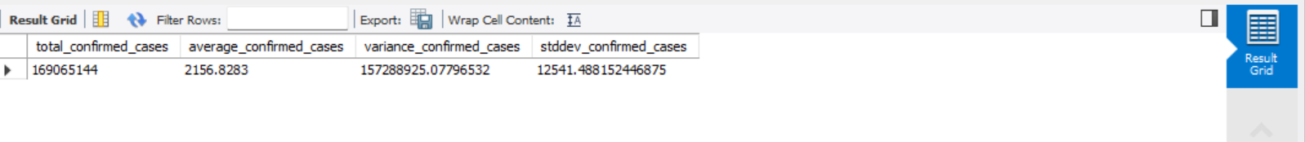
Check how corona virus spread out with respect to confirmed case

Slide 18
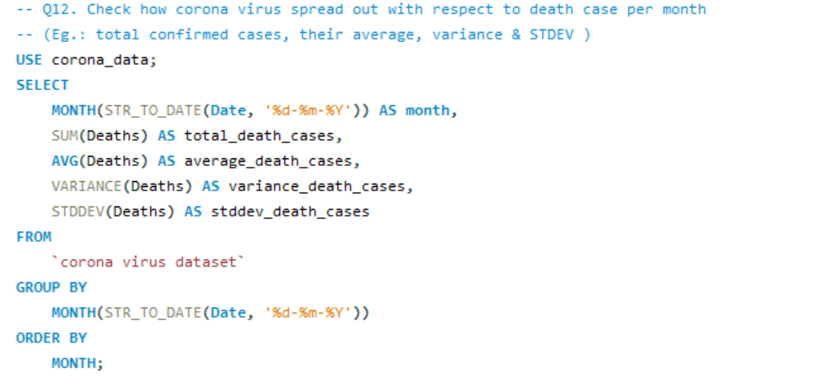
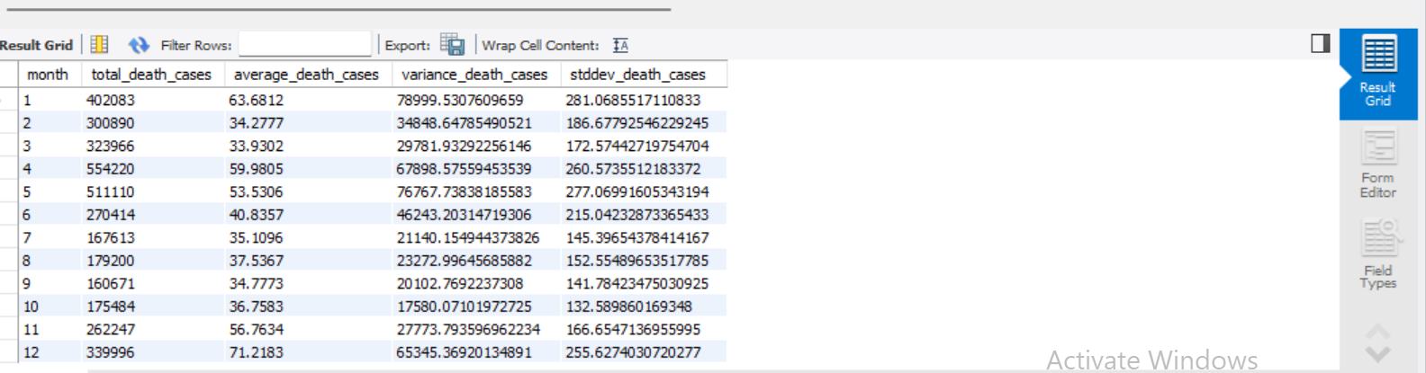
Check how corona virus spread out with respect to death case per month

Slide 19
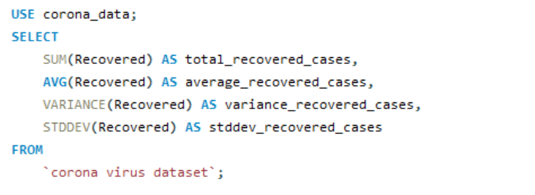
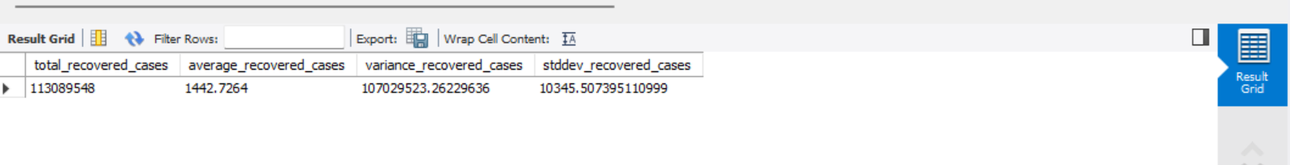
Check how corona virus spread out with respect to recovered case-- (Eg.: total confirmed cases, their average, variance & STDEV )USE corona_data;

Slide 20
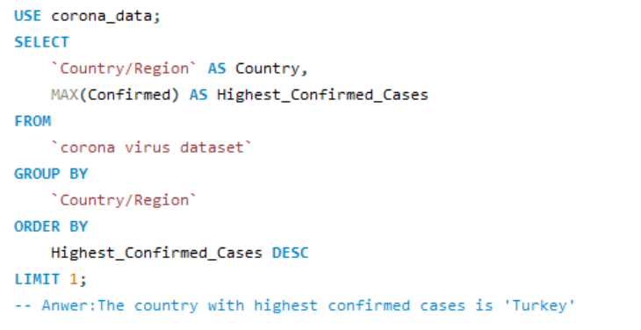
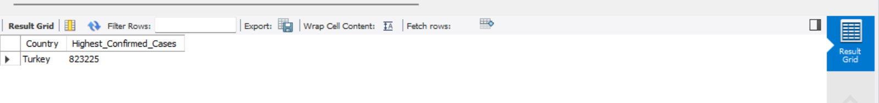
Find Country having highest number of the Confirmed case

Slide 21
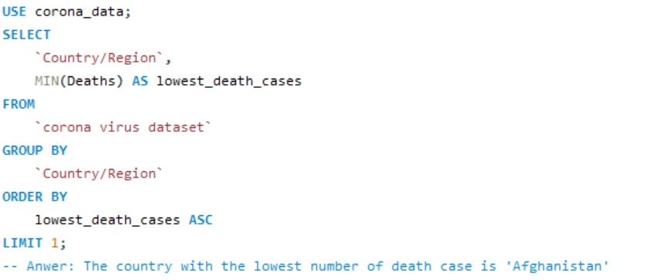
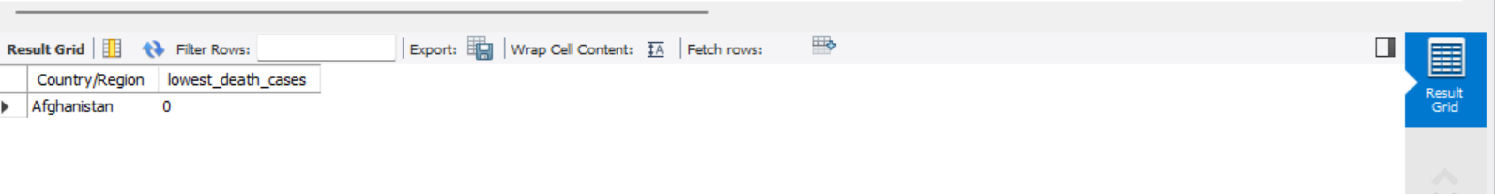
Find Country having lowest number of the death case

Slide 22
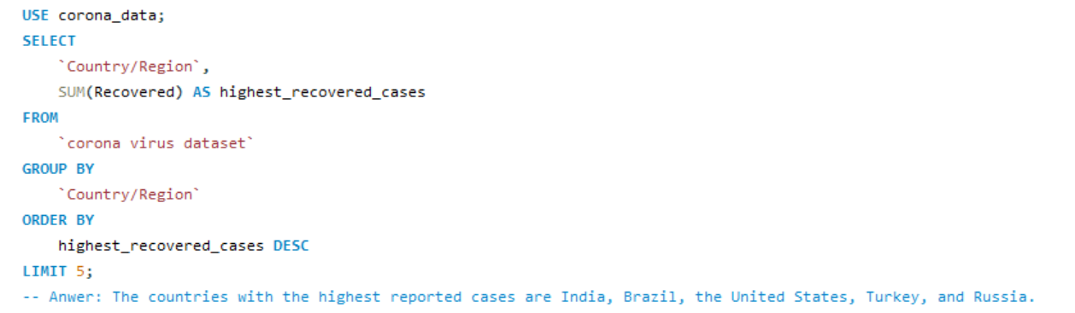
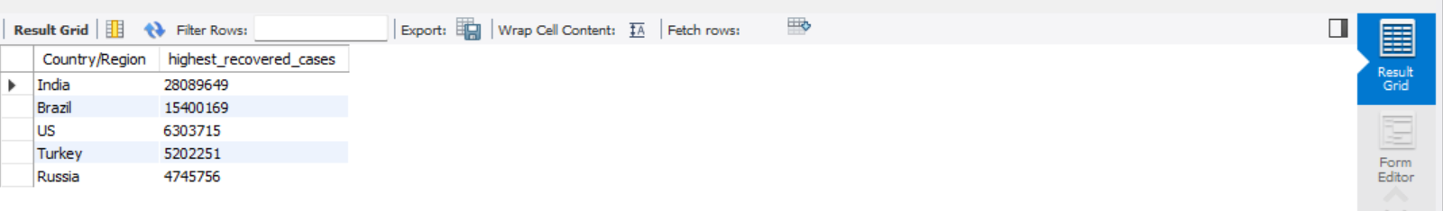
Find top 5 countries having highest recovered case

Slide 23
INSIGHT
Highest and Lowest Averages:
The average number of recovered cases is highest in the 12th month and lowest in the second month.
Highest and Lowest Frequencies:
The 6th month sees the highest frequency of deaths, while the 8th month has the lowest.
The 12th month has the highest frequency of recoveries, with the 1st month having the lowest.
Highest Total Cases:
The 4th month records the highest confirmed cases, while the 7th month has the lowest.
The 4th month also records the highest number of deaths, with the 9th month having the lowest.
The 5th month sees the highest total recovered cases, with the 7th month having the lowest.
Year-wise Observations:
2020 records the highest values for confirmed and recovered cases, while 2021 records the highest for deaths.
Overall Statistics:
The total spread of COVID-19 is substantial, with over 169 million confirmed cases.
The average confirmed cases variance and standard deviation indicate significant variability in spread.
Country-specific Observations:
Turkey has the highest confirmed cases, while Afghanistan has the lowest number of deaths.
India, Brazil, the United States, Turkey, and Russia are the countries with the highest reported cases.

Slide 24
CONCLUSION
The insights drawn from the data suggest a dynamic and varied pattern of COVID-19 spread across different time periods and regions. While some months and years have seen peaks in confirmed cases, deaths, and recoveries, others have experienced relatively lower numbers. The data also highlights the disparities among countries in terms of the severity of the pandemic. Understanding these patterns is crucial for formulating effective public health policies and interventions to mitigate the impact of the virus. Further analysis could delve into factors influencing these variations, such as government responses, healthcare infrastructure, and population demographics.

